Slide 1
CM1605 Web Technology
JavaScript Loops, Objects and Functions
Week 6| Janani Harischandra

Slide 2
Learning Outcomes
Covers LO2 for Module
On completion of this lecture, students are expected to be able to:
Understand the concept of JavaScript Repetition Structure and Functions and Objects.
Apply knowledge of JavaScript Loops to perform repetitive tasks in hypertext documents.
Demonstrate a good level of knowledge to create interactive hypertext documents using Functions.

Slide 3
Content
JavaScript Loops
JavaScript Objects
String
Date
Math
Array
JavaScript Functions
Variable Scope

Slide 4
JavaScript Loops
There are cases in which you have to traverse through every item in an array and do something with it. Eg: 25 elements
Instead of adding several almost equal lines in a script we can use loops to perform a task like this.
In JavaScript, there are different kind of loops:
For
for/in - loops through the properties of an object
while
do/while

Slide 5
For loop
Syntax
for( initialize the variable; test the condition; alter the value; )
{
// do something
}
Example
for( let i = 0; i <= 2; i++ )
{
alert( i ); // This loop will trigger three alerts, reading "0", "1", and "2" respectively.
}

Slide 6
While loop
Syntax
while (condition) { // code block to be executed }
Example
while (i < 10) { text += "The number is " + i; i++; }

Slide 7
Do while Loop
This loop will always be executed at least once, even if the condition is false, because the code block is executed before the condition is tested:
Syntax
do {
code block to be executed } while (condition);
Example
let text = ""; let i = 0; do { text += "The number is " + i; i++; } while (i < 5);

Slide 8
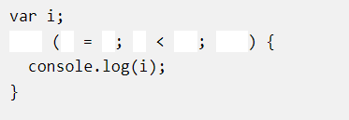
Exercise
Create a loop that runs from 0 to 9.

Slide 9
JavaScript Break and Continue
The break statement "jumps out" of a loop.
-The break statement will break the loop and continue executing the code that follows after the loop (if any).
The continue statement "jumps over" one iteration in the loop.
The continue statement will break the current loop and continue with the next value.

Slide 10
JavaScript Break and Continue
Break | Continue
for (i = 0; i < 10; i++) { if (i ==3) { break; } document.write("The number is " + i +”<br/>”); } | for (i = 0; i < 6; i++) { if (i == 3) { continue; } document.write("The number is " + i +”<br/>”); }
Output | Output
The number is 0 The number is 1 The number is 2 The number is 4 The number is 5 The number is 6 The number is 7
The number is 0 The number is 1 The number is 2

Slide 11
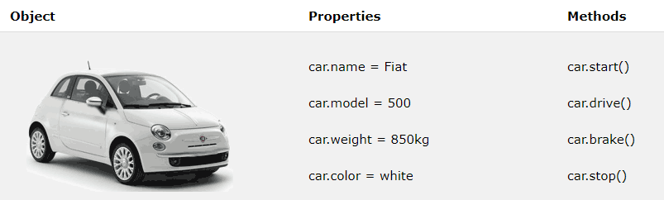
Objects

Slide 12
JavaScript Objects
JavaScript is an Object based scripting language.
You can define your own objects and an object is a collection of properties.
An object is just a special kind of data type.
An object has properties and methods.

Slide 13
String Object
JavaScript strings are primitive values, created from literals:
Eg:
let firstName = "John";
Strings can also be defined as objects with the keyword new:
Eg:
let firstName = new String("John");

Slide 14
Date Object
By default, JavaScript will use the browser's time zone and display a date as a full text string:
Eg: Tue Sep 29 2020 13:56:46 GMT+0530 (India Standard Time)
Creating Date Objects
new Date() new Date(year, month, day, hours, minutes, seconds, milliseconds) new Date(milliseconds) new Date(date string)

Slide 15
Math Object
The JavaScript Math object allows you to perform mathematical tasks on numbers.
Math.PI; // returns 3.141592653589793
Math.round(4.7); // returns 5
Math.pow(8, 2); // returns 64
Math.sqrt(64); // returns 8
Math.abs(-4.7); // returns 4.7
Math.ceil(4.4); // returns 5
Math.floor(4.7); // returns 4

Slide 16
Array Object
The Array object is used to store multiple values in a single variable.
Syntax :
const array_name = [item1, item2, ...];
Regular & Literal
const cars = new Array("Saab", "Volvo", "BMW");
Arrays are a special type of objects. The type of operator in JavaScript returns "object" for arrays.
However, JavaScript arrays are best described as arrays.
Arrays use numbers to access its "elements". In this example, car[0] returns “Saab”.

Slide 17
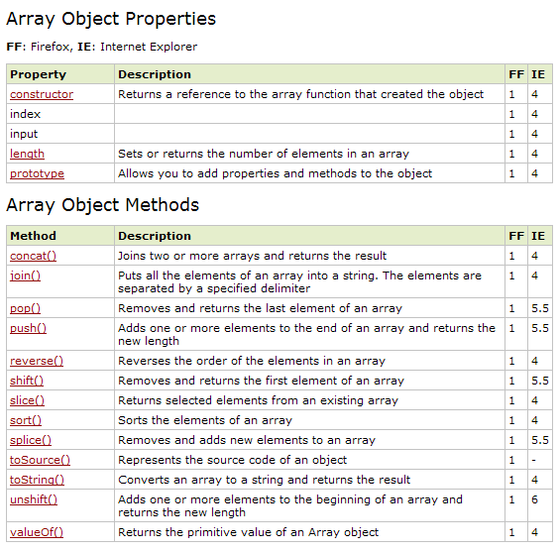
Arrays

Slide 18



Array Methods

Slide 19
Discuss
How to delete an element in a Array?
How to sort numeric elements in a Array?

Slide 20
JavaScript Functions
A function is a bit of code that doesn’t run until it is referenced or called.
Functions let you group a series of statements together to perform a specific task.
If different parts of a script repeat the same task, you can reuse the function (rather than repeating the same set of statements).
There are two types of functions
Native - alert(), confirm(), prompt() , parseInt("123")
Custom - those that you make up yourself

Slide 21
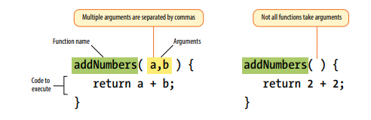
Anatomy of a Function

Slide 22
Custom Functions
Functions can be defined both in the <head> and in the <body> section of a document.
However, to assure that a function is read/loaded by the browser before it is called, it could be wise to put functions in the <head> section.
Syntax
function name() {
// Our function code goes here.
}

Slide 23
Notes on Functions
A function with no parameters must include the parentheses () after the function name.
Do not forget about the importance of capitals in JavaScript!
The word function must be written in lowercase letters.
You must call a function with the exact same capitals as in the function name.

Slide 24
Function Example
Declaration:
function foo()
{ alert("Our function just ran!");
// This code won't run until we call the function 'foo()'
}
Function call:
foo(); // Alerts "Our function just ran!"

Slide 25
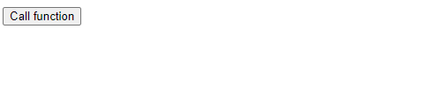
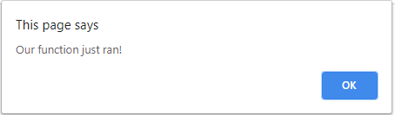
The Complete Example
<html>
<head>
<script>
function foo()
{ alert("Our function just ran!");
// This code won't run until we call the function 'foo()'
}
</script>
</head>
<body>
<form>
<input type="button" onclick=“foo()" value="Call function">
</form>
</body>
</html>

Slide 26
Function Arguments
You can “pass arguments” (provide data) to native and custom functions in order to apply a function’s logic to different sets of data at different times.
Syntax
function alertArraySize(arr) {
alert(arr.length);
}

Slide 27
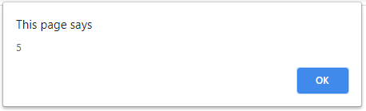
The Complete Example
<html>
<head>
<script>
function alertArraySize(arr) {
alert(arr.length);
}
</script>
</head>
<body>
<script>
let test = [1,2,3,4,5];
alertArraySize(test); // Alerts "5“
</script>
</body>
</html>

Slide 28
Return Value
It’s pretty common to use a function to calculate something and then give you a value that you can use elsewhere in your script.
The return keyword inside a function effectively turns that function into a variable with a dynamic value!
Syntax
function addNumbers(a,b)
{
return a + b;
}

Slide 29
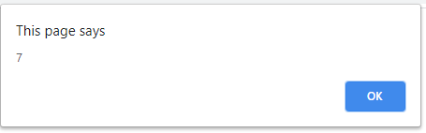
The Complete Example
<html>
<head>
<script>
function addNumbers(a,b) {
return a + b;
}
</script>
</head>
<body>
<script>
alert( addNumbers(2,5) ); // Alerts "7"
</script>
</body>
</html>

Slide 30
Class Activity
Write a JavaScript function that accepts a number as a parameter and check the number is prime or not.
How to accept a number?
Hardcoded?
Prompt box?
HTML form?

Slide 31
function isPrime(num) {
// Check if the number is less than 2
if (num < 2) {
return false;
}
// Check if the number is 2
if (num === 2) {
return true;
}
// Check if the number is even
if (num % 2 === 0) {
return false;
}
// Check for prime number
for (let i = 3; i <= Math.sqrt(num); i += 2) {
if (num % i === 0) {
return false;
}
}
return true;
}

Slide 32
Reading
Duckett, J. (2014), JavaScript & JQuery, interactive front-end web development, Wiley.
Robbinson, J . (2018), Learning Web Design, A Beginner’s Guide to HTML,CSS, JavaScript, And Web Graphics, O’Reilly.
Online :
https://www.w3schools.com/js/js_objects.asp
https://www.w3schools.com/js/js_function_definition.asp

